Slide 1
Showroom3D_Web(React)
Archana
28 August,2024

Slide 2
Requirements
State management
Modularization

Slide 3
Use cases
Light controls in the scene to reflect on the UI and vice versa
Update animations,material variants values based on the object added / selected
Modes (arrangement,measurements,camera,collaboration)
Update light control values based on Day/Night toggle
Add objects to Physics world when new object added into the scene

Slide 4
State management

Slide 5
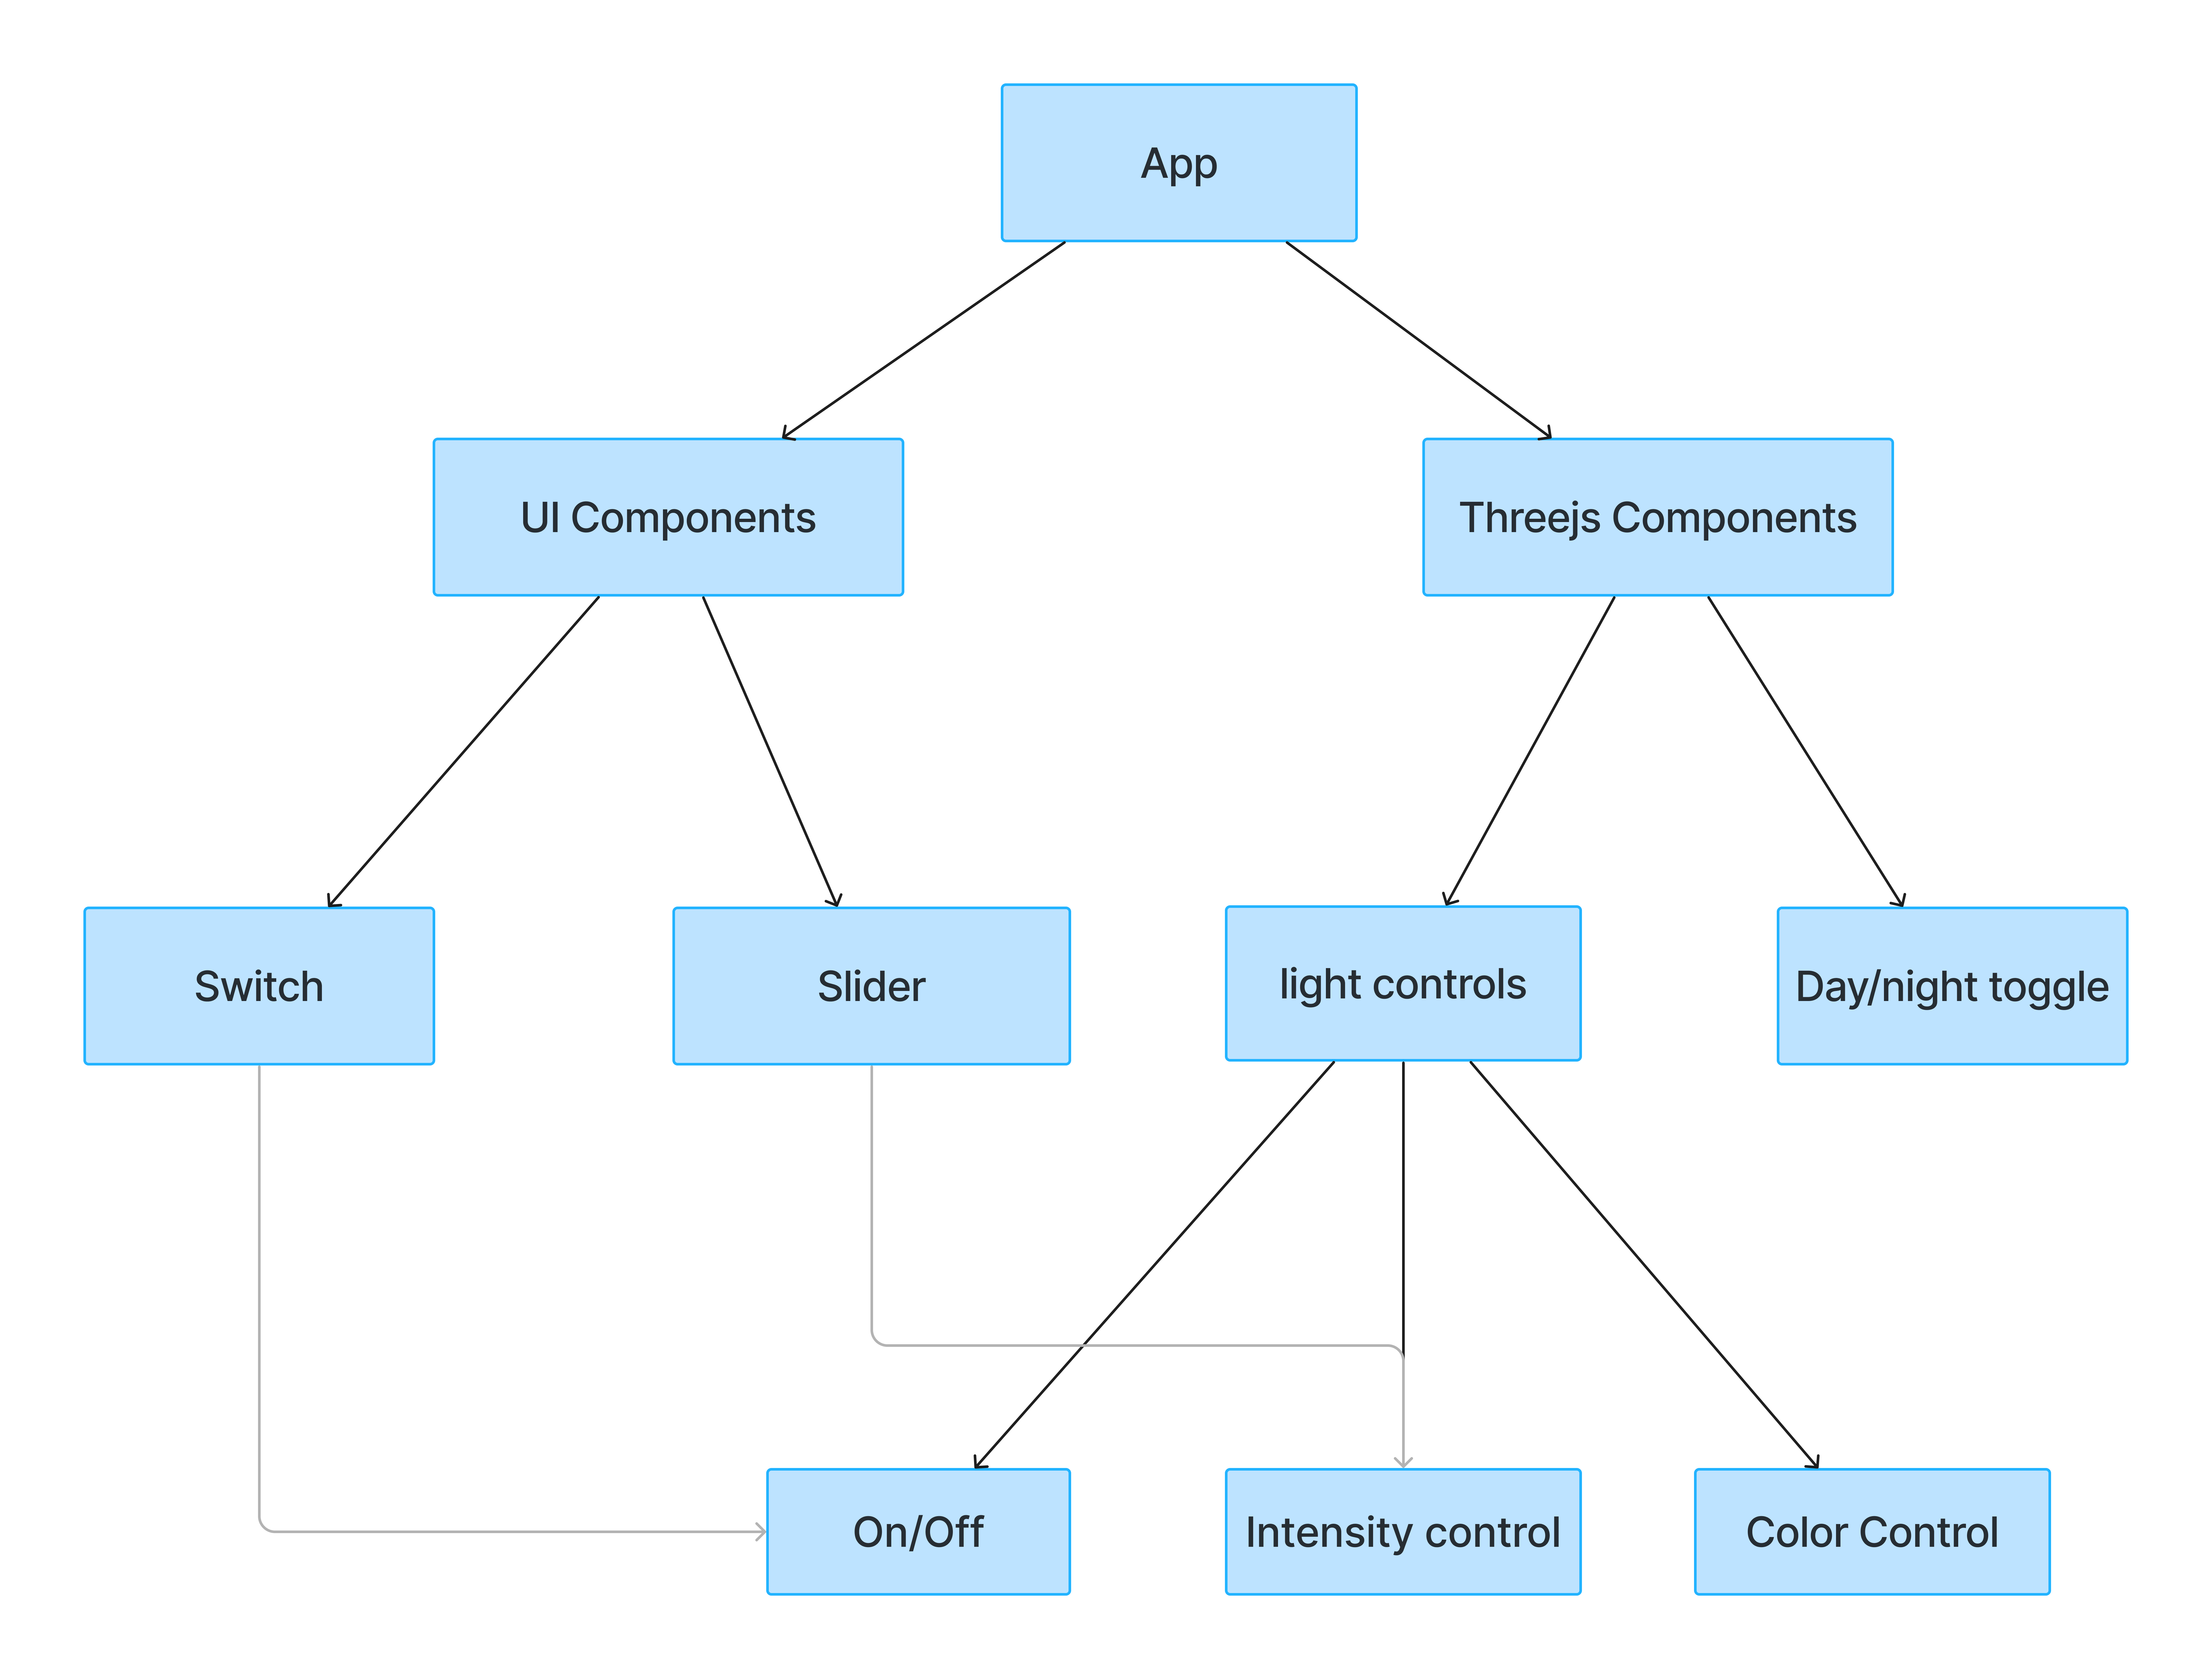
Modularization

Slide 6
Modularization

Slide 7
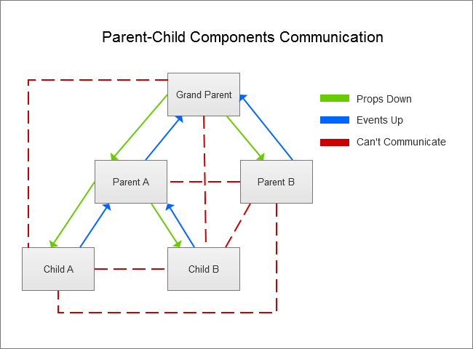
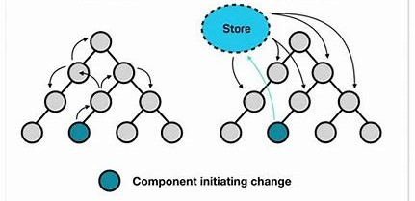
Parent child relation in react

Slide 8
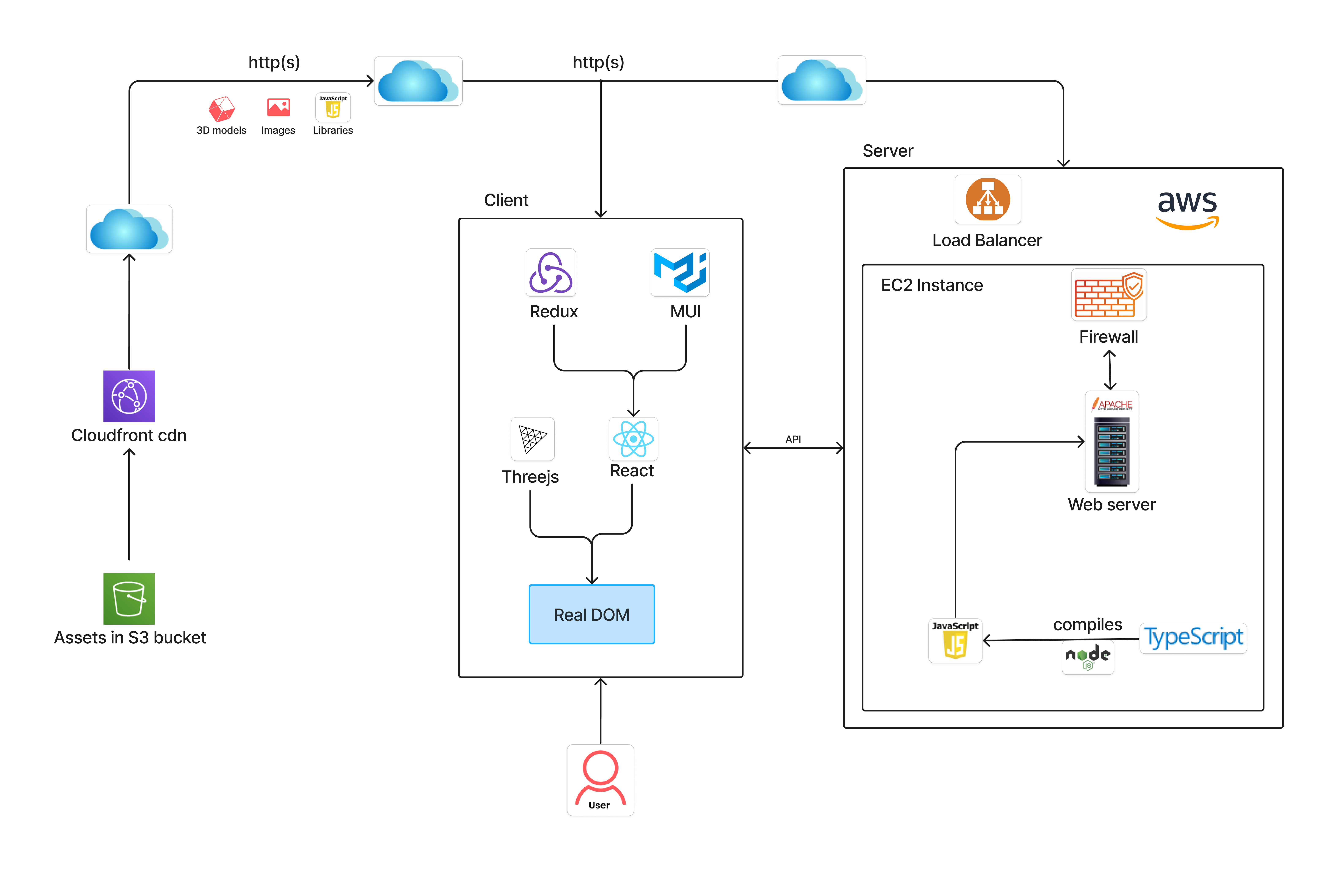
Architecture diagram

Slide 9
Add furniture objects

Slide 10
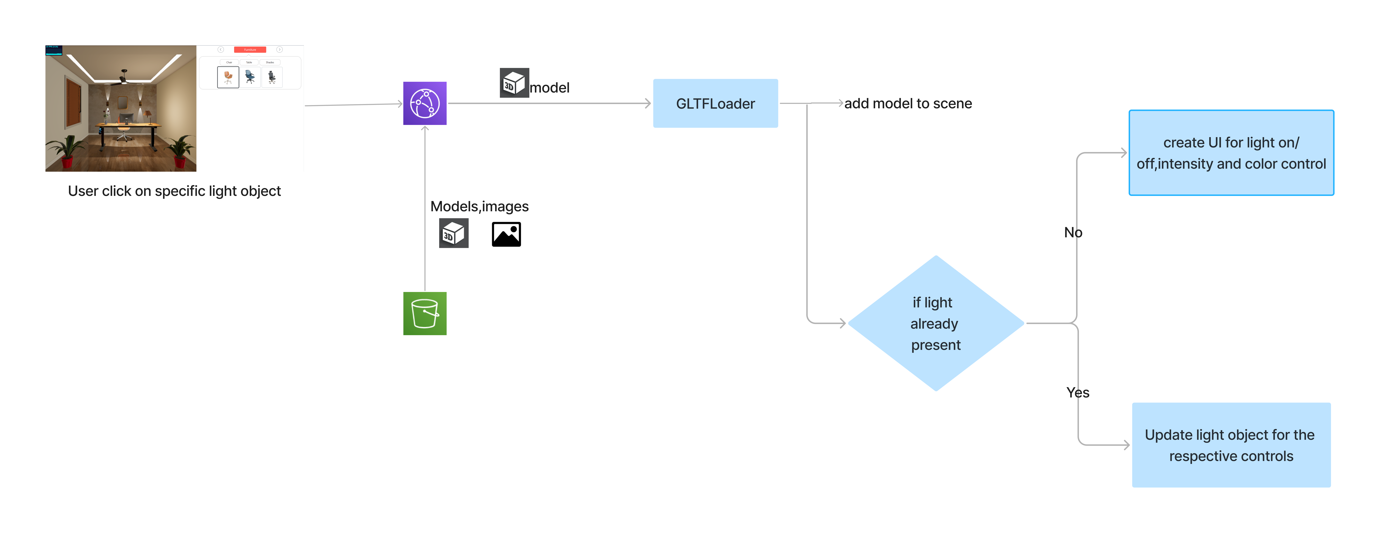
Add light objects

Slide 11
Process to move the Showroom3D demo to React framework
Create UI by using MUI components.
Load basic threejs scene
Enable camera controls,viewpoints and themes
Setup postprocessing effects
Load different furniture types and its related dynamics,variants and etc by maintaining state to reflect accurately on the UI
Load different light types and show related light controls by maintaining state to reflect accurately on the UI
Implement arrangement features
Implement measurements features
Implement HD Render feature

Slide 12
Major Technologies
Threejs
Typescript
React
Redux
MUI

Slide 13
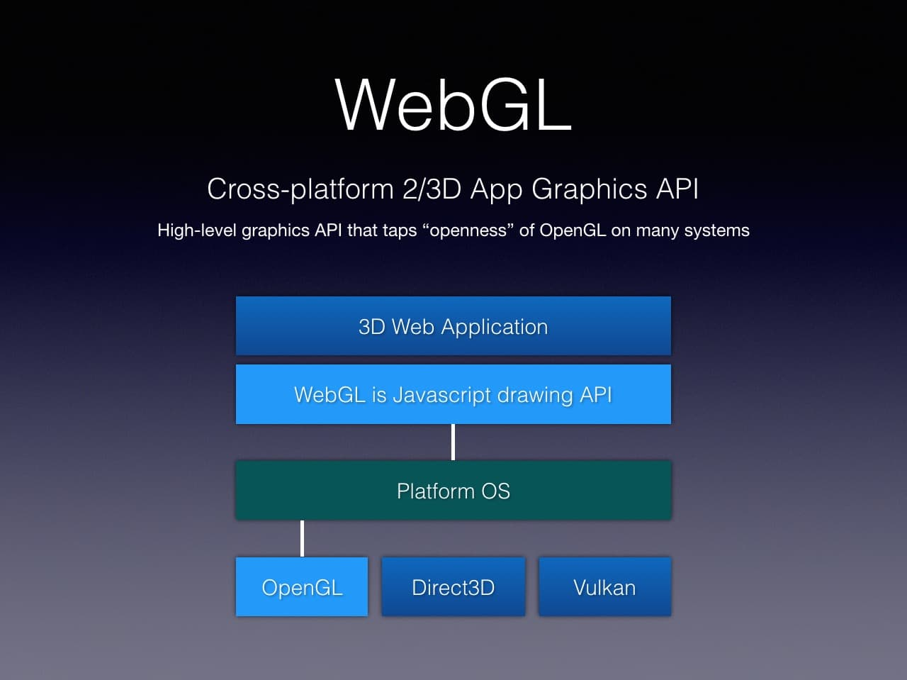
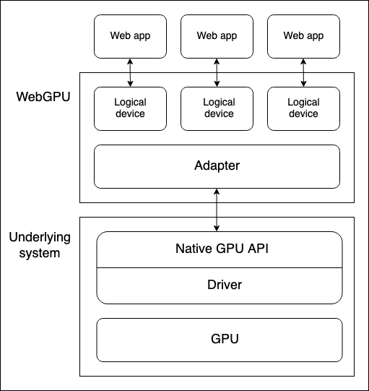
Threejs

Slide 14
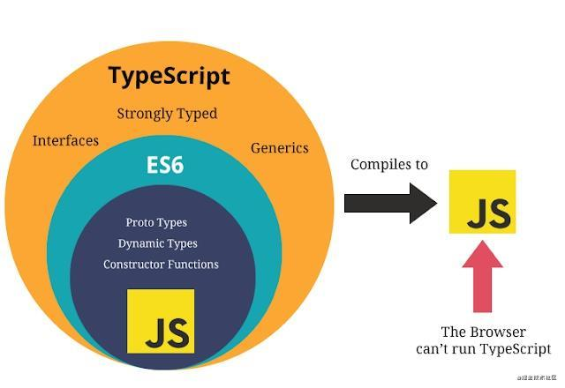
TypeScript
Static Typing
JavaScript Compatibility
Improved Code Readability

Slide 15
Javascript
why js popular?
JavaScript is the only programming language that is natively supported by all web browsers
JavaScript is designed to handle events and asynchronous operations (like handling multiple tasks simultaneously), which is crucial for creating dynamic and responsive web applications.
JavaScript can be used for both front-end and back-end development and it can be used to build cross-platform applications
why is async not in c/other languages
Languages like C were designed to be close to the hardware, prioritizing performance and control. Asynchronous programming often introduces overheads, which was initially considered unacceptable.
These languages were predominantly procedural, making it less intuitive to express asynchronous concepts.
While threads can be used for concurrency, they're often inefficient for I/O-bound tasks, which is a primary use case for asynchronous programming.
why scripting language on the web
Cross-Platform Compatibility
Scripting languages in web browsers run in a sandboxed environment, which restricts access to the underlying system and protects users from malicious code. This makes scripting languages safer for use in a web context.
handle asynchronous tasks efficiently, which is essential for web applications that need to interact with servers, load data in the background, or handle multiple user events simultaneously.

Slide 16
Nodejs
why is nodejs so popular
Node.js is built on Google's V8 JavaScript engine, which compiles JavaScript directly into machine code, making it extremely fast.
Node.js uses asynchronous, non-blocking, event-driven architecture, which allows it to handle a large number of simultaneous connections efficiently.
Event-driven architecture is a design pattern where system components communicate by generating, detecting, and responding to events. Events represent significant occurrences, such as user actions or changes in the system state
why nodejs outperform apache
Node.js employs an event loop and non-blocking I/O, allowing it to handle multiple concurrent connections efficiently without creating new threads for each request, it focus on I/O bound tasks.
Apache, on the other hand, typically creates a new thread for each request, which can become resource-intensive under heavy load, it focus on CPU-bound tasks.
why is nodejs environment so reliable
npm allows developers to define scripts in their package.json file, making it easy to automate common tasks like building, testing, and deploying applications. This feature reduces the need for complex build tools and makes project automation more accessible
npm uses lockfiles to ensure that the same package versions are installed across different environments, which enhances consistency and reliability in deployment.

Slide 17
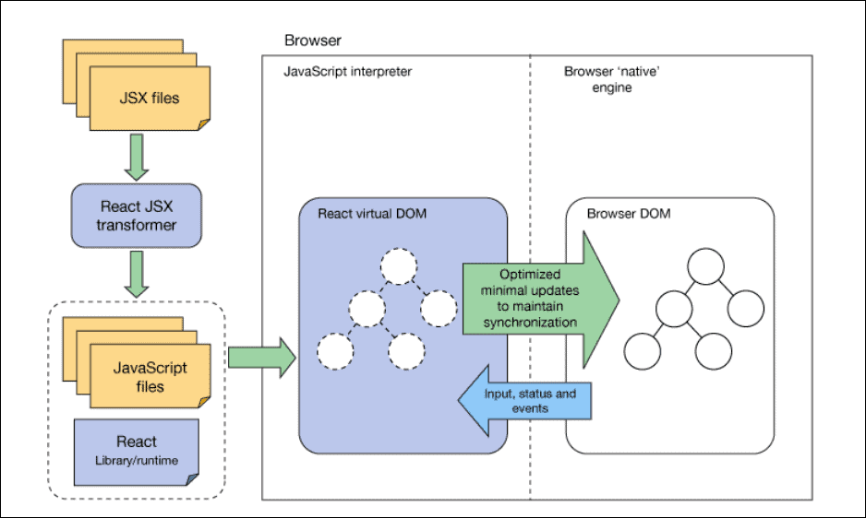
React Architecture

Slide 18
React
Modular and Reusable
By breaking down the UI into smaller, manageable components, React promotes modularity and we can reuse these components across the app
Virtual DOM
When the state of an object changes, React updates the virtual DOM first, which then compares it with the real DOM and makes only the necessary updates. This results in faster and more efficient rendering.
JSX – JavaScript Syntax Extension
With jsx, we can write html code inside js file, so that we can write reusable UI components as well
Dynamic Content
We can dynamically update content of dynamics,material variants etc when we add object
Predictable State Management
By using redux or react context, values will be explicitly updated in the state
Scalability
The ability to break down the UI into reusable components and manage state efficiently helps in scaling applications as they grow

Slide 19
React Forms
React forms can be either “controlled” or “uncontrolled.”
Controlled forms store input values in React state. Each input’s value is set on every re-render from that state.
This approach allows for complex validation. For example, you can check if an email address is properly formatted or if a password meets complexity requirements or formatting phone numbers.
You can conditionally enable or disable form fields based on other inputs.For instance, showing additional fields when a user selects a specific option from a dropdown.
Uncontrolled forms don’t store input values in state. They rely on native HTML form behavior.
Frequent re-renders (may impact performance).
Difficulty handling dynamic forms with varying field counts.
Workarounds exist, but they add complexity1.

Slide 20
React Router
Single Page Application (SPA) Navigation
React is commonly used to build Single Page Applications (SPAs), where different parts of the application are dynamically rendered without reloading the entire page. React Router enables you to manage this dynamic navigation effectively.
URL-Based Navigation
React Router allows you to associate specific URLs with different components or views in your application.
Nested Routes
It supports nested routing, allowing you to create complex routing hierarchies where routes can be nested within other routes. This is useful for creating layouts and managing components that need to be displayed within other components.
Route Parameters
It allows you to capture and use dynamic parameters in URLs, making it easier to handle things like user profiles (/users/:userId) or product pages (/products/:productId).
Conditional Rendering
With React Router, you can conditionally render different components based on the current URL. This makes it easier to manage which parts of your app are visible at any given time.

Slide 21
React Hooks
Hooks allow function components to have access to state and other React features.
Hooks allow us to "hook" into React features such as state and lifecycle methods.
UseState
This allows us to track state in a function component.
UseEffect
The useEffect Hook allows you to perform side effects in components.
Some examples of side effects are: fetching data, directly updating the DOM, and timers.
To update light values based on Day/night toggle state value we can use UseEffect hook
UseRef
The useRef Hook allows you to persist values between renders.
It can be used to store a mutable value that does not cause a re-render when updated.
It can be used to access a DOM element directly.

Slide 22
React Hooks cont.
UseContext
React Context is a way to manage state globally.
It can be used together with the useState Hook to share state between deeply nested components more easily than with useState alone.
We can store the scene and renderer values using the useContext hook, allowing us to access them throughout the application
we can update day/night toggle state value
Drawbacks:
When the context value changes, all components consuming that context will re-render, potentially leading to performance issues if the context is used widely in the application.
React Context triggers updates based on changes to the context value and propagates these updates directly down the component tree.
Doesn't natively support middleware for tasks like logging, handling side effects, or performing asynchronous operations.
Difficult to Debug

Slide 23
Why Redux
Redux triggers updates based on dispatched actions and updates its global state through reducers, with connected components re-rendering based on state slices they subscribe to.
Middleware is often used to handle side effects, perform asynchronous actions, log actions, or conditionally dispatch actions.
Async Actions: Handling asynchronous operations like API calls (redux-thunk, redux-saga).
Crash Reporting: Catching and reporting errors that occur during dispatching (redux-crash-reporting).
Logging: Logging dispatched actions and state changes (redux-logger).
Features of Redux DevTools:
Action History: It shows a history of all actions that have been dispatched, along with the state before and after each action.
Time Travel: You can "time travel" through actions, meaning you can go back and forth through the history of actions to see how the state changes over time.
Action Replay: You can replay specific actions or sequences of actions to see their effects on the state.
Dispatch Actions: You can manually dispatch actions from the DevTools to test how they affect the state.
Custom Filters: You can filter actions to focus on specific parts of the app.

Slide 24
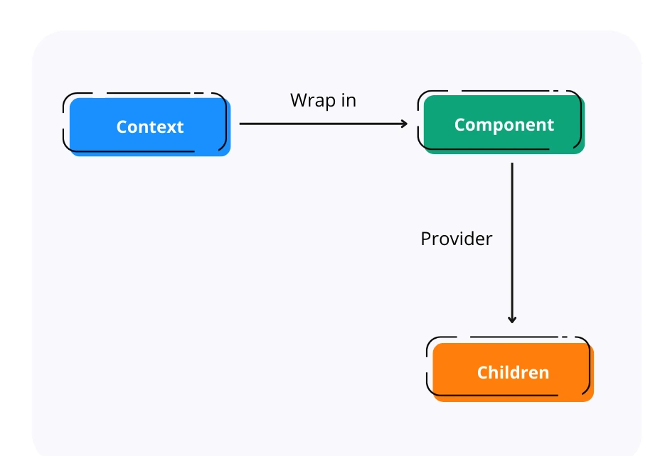
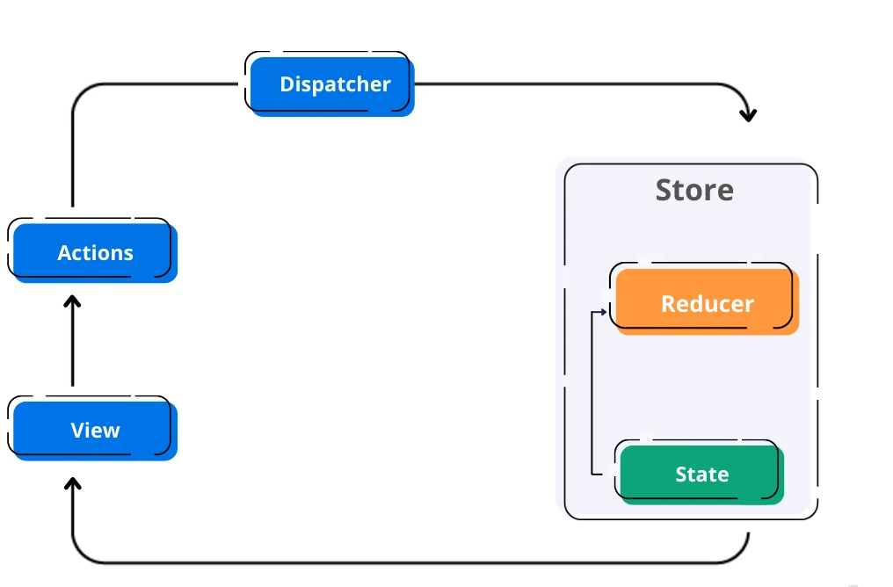
React Context vs Redux
React Context
Redux
Ease of Use

Slide 25
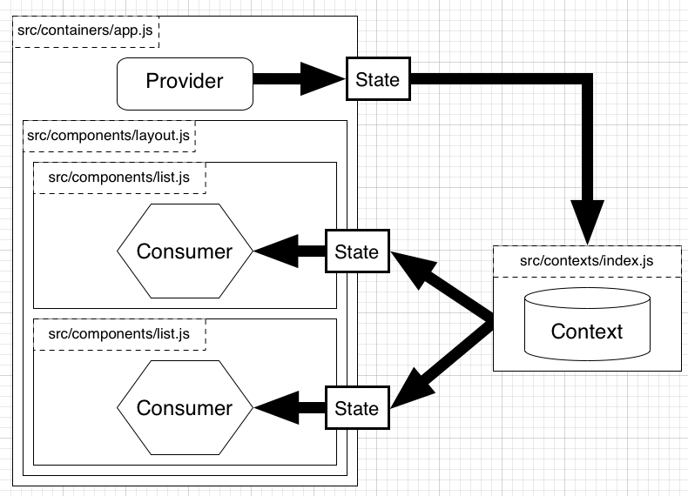
React Context
Ease of Use
Improved Performance
Global State Management

Slide 26
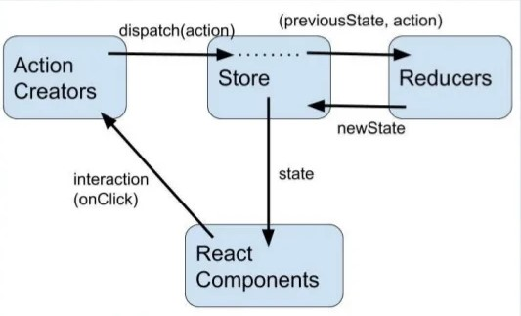
Redux
Centralized state management for better organization and predictability.
Improved Maintainability
Time travel debugging for easier development and troubleshooting
Immutable state for better performance and data integrity.
https://redux.js.org/tutorials/fundamentals/part-1-overview

Slide 27
Context API Vs Redux
Context API | Redux
Requires minimal Setup | Requires extensive setup to integrate it with a React Application
Specifically designed for static data, that is not often refreshed or updated | Works like a charm with both static and dynamic data
Adding new contexts requires creation from scratch | Easily extendible due to the ease of adding new data/actions after the initial setup
Debugging can be hard in highly nested React Component Structure even with Dev Tool | Incredibly powerful Redux Dev Tools to ease debugging
UI logic and State Management Logic are in the same component | Better code organization with separate UI logic and State Management Logic

Slide 28
MUI
Adheres to Google Material Design
Pre-built Components
Performance
Accessibility
Responsive Design
Customization and Theming
Drawbacks:
Some components, such as carousel and color picker, are not available in MUI
Bundle Size

Slide 29
Bootstrap Vs MUI
Bootstrap | MUI
Unnecessary JS, jQuery scripts, and large class definitions might make that application heavy | It works on React JS components,doesn’t require any library to work
comparatively less customizable than Material UI. | Material UI is highly customizable
High speed of development because of reusable code | Speed of development is lesser than compared to bootstrap but can be increased by extensive use of reusable components and templates.

